Slide 1
DIGITAL PORTFOLIO

Slide 2
STUDENT INFORMATIONS
STUDENT NAME: P. KAVIYA
REGISTER NUMBER AND NMID: 222403824/asunm293222403824
DEPARTMENT: BSC COMPUTER SCIENCE
COLLEGE NAME: VIDHYASAGAR WOMEN’S COLLEGE

Slide 3
MY PORTFOLIO
BY:
P. KAVIYA

Slide 4
AGENDA
Problem Statement
Project Overview
End User
Tools and Technologies
Portfolio Design and Layout
Features and Functionality
Result and Screenshot
Conclusion
Github Link

Slide 5
PROBLEM STATEMENT
Lack of centralized platform to showcase personal projects.
Difficulty for recruiters to assess candidates’ skills quickly.
Portfolio creation requires technical knowledge.
No personalized, userr-friendly design avilable.
Existing solutions are either costly or too complex.

Slide 6
PROJECT OVERVIEW
Development of an interactive personal portfolio website.
Showcasing academic, professional, and personal achievements.
Responsive design for mobile, tablet, and desktop.
Integration with GitHub for project repositories.
Highlighting skills, projects, and contact details.

Slide 7
END USER
Students building their first portfolio.
Professional wanting an online presence.
Recruiters looking for quick skill validation.
Job seekers who want to showcase projects.
Freelancers promoting their skills.

Slide 8
TOOLS AND TECHNOLOGIES
Frontend: HTML,CSS, Javascript.
Framework: React.js (or Bootstrap for UI).
Backend: Node.js / Express.js.
Database: MongoDB / Firebase.
Version control: Git & GitHub.
Hosting: Netlify / Vercel / GitHub Pages.

Slide 9
PORTFOLIO DESIGN AND LAYOUT
Minimalist and clean design.
Homepage with personal introduction.
Dedicated sections for projects, skills and achievements.
Responsive and mobile-friendly layout.
Consistent color scheme and typography.

Slide 10
FEATURES AND FUNCTIONALITY
Interactive project showcase with screenshots.
Resume download option.
Contact form with email integration.
Live links to GitHub repositories.
Easy-to-update structure for adding new projects.

Slide 11
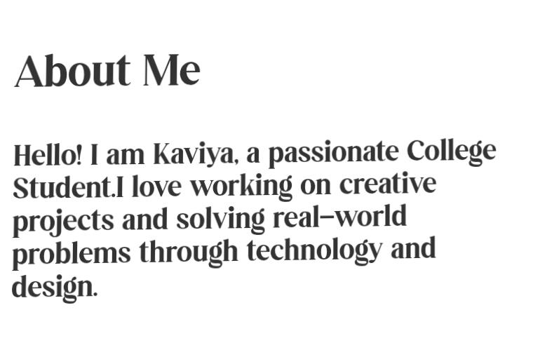
RESULT AND SCREENSHOTS

Slide 12
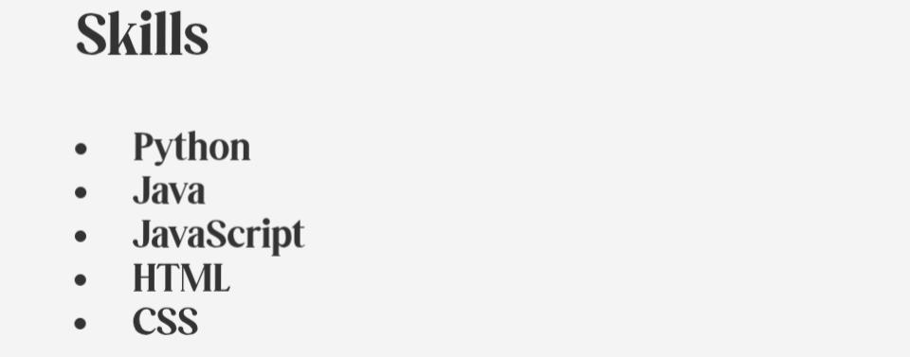
RESULT AND SCREENSHOTS

Slide 13
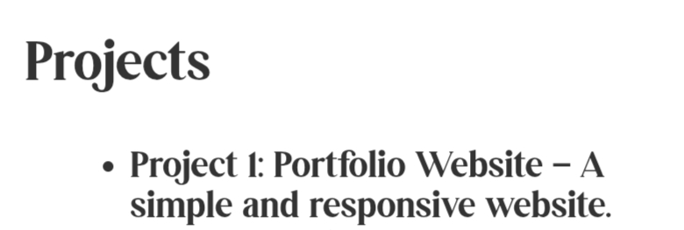
RESULT AND SCREENSHOTS

Slide 14

RESULT AND SCREENSHOTS

Slide 15

RESULT AND SCREENSHOTS

Slide 16
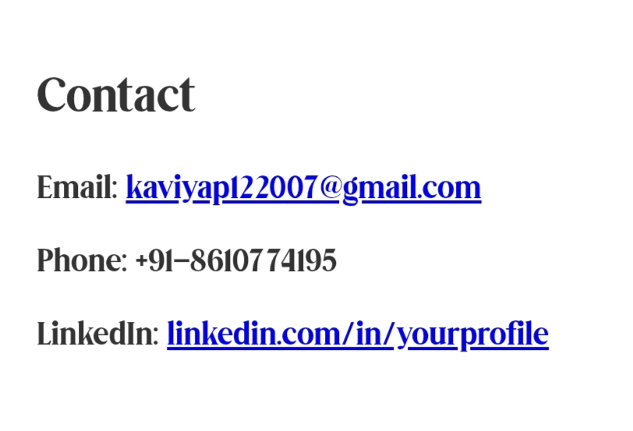
RESULT AND SCREENSHOTS

Slide 17
CONCLUSION
Portfolio website solves the problem of limited exposure.
Helps end users stand out in job applications.
Improves recruiter experience in candidate evaluation.
Provides an interactive and professional way to showcase skills.
Encourages continuous personal development.

Slide 18
THANK YOU

